Slide 1
IBM University Engagement Project Submission
“Exploring the Power of Agentic AI with IBM Granite and IBM Bob”

Slide 2

Project Tile – Electric Vehicle Charging Optimization Agent
Domain of Project – Transportation
Student Name | Recent Passport Photo | Email ID | Mobile number [WhatsApp]
PEDDADEVARA JAVEED |  | peddadevarajaveed@gmail.com | 9390812711

Slide 3
Problem Statement – Electric Vehicle Charging Optimization Agent
The Challenge:
With the rapid growth of electric vehicles (EVs), charging stations often face high demand, uneven usage, and inefficient energy distribution. Peak-hour charging can overload the grid and increase electricity costs for both operators and users. There is a need for an intelligent system that can analyze charging patterns and optimize EV charging schedules.
The Objective:
Build an Electric Vehicle Charging Optimization Agent that analyzes charging station usage data and provides intelligent recommendations to optimize charging schedules and energy usage.
Charging Pattern Analysis:
Analyze historical EV charging data to understand peak usage hours, charging demand, and station utilization.
Charging Schedule Optimization:
Recommend optimal charging schedules to balance demand and reduce peak-hour congestion.
Energy Demand Prediction:
Predict future charging demand based on historical patterns and user behavior.
Cost Optimization Insights:
Suggest charging during low-tariff periods to reduce electricity costs for EV users and charging station operators.
Tech Stack (Mandatory):
IBM Bob + IBM Cloud + IBM Granite

Slide 4
Proposed Solution – Electric Charging Optimization Agent
The proposed solution is to develop an intelligent Electric Vehicle (EV) Charging Optimization Agent that helps EV users find the most suitable charging stations based on their location, battery level, charging requirements, and station availability. The system provides real-time information about nearby charging stations, charging speed, and estimated charging costs, helping users make better charging decisions.
The agent uses Artificial Intelligence (AI) and optimization algorithms to identify the best charging time and station by considering electricity prices, traffic conditions, waiting times, and energy demand. It can recommend off-peak charging periods when electricity costs are lower and distribute charging demand efficiently across available stations. This helps reduce charging expenses, avoid overcrowding, and improve the utilization of charging infrastructure.
The system aims to provide a user-friendly and efficient charging experience through a mobile or web application. It can offer route-based charging recommendations, estimated battery charging time, and notifications about charging station availability. By optimizing energy consumption and reducing unnecessary travel to unavailable stations, the proposed solution supports sustainable transportation, improves energy efficiency, and encourages the adoption of electric vehicles.
The proposed system can also integrate with smart grids and renewable energy sources, such as solar and wind power, to make EV charging more sustainable. It can prioritize charging when renewable energy is available and adjust charging schedules according to electricity demand. The system can further analyze user charging patterns to provide personalized recommendations and improve its performance over time. This approach helps reduce carbon emissions, balance the electricity load, lower charging costs, and create a smarter and more reliable electric vehicle charging network.

Slide 5
Technology Used
IBM Bob platform - For designing and orchestrating multi-agent workflows to optimize EV charging schedules, select suitable charging stations, and coordinate charging decisions.
RAG(Retrieval-Augmented Generation) – To retrieve real-time and relevant data about EV charging stations, electricity prices, station availability, and charging requirements before generating intelligent recommendations.
Vector Database (FAISS/Chroma) – For storing and retrieving relevant EV charging information, station details, and energy-management knowledge to support fast, context-aware recommendations through RAG.

Slide 6
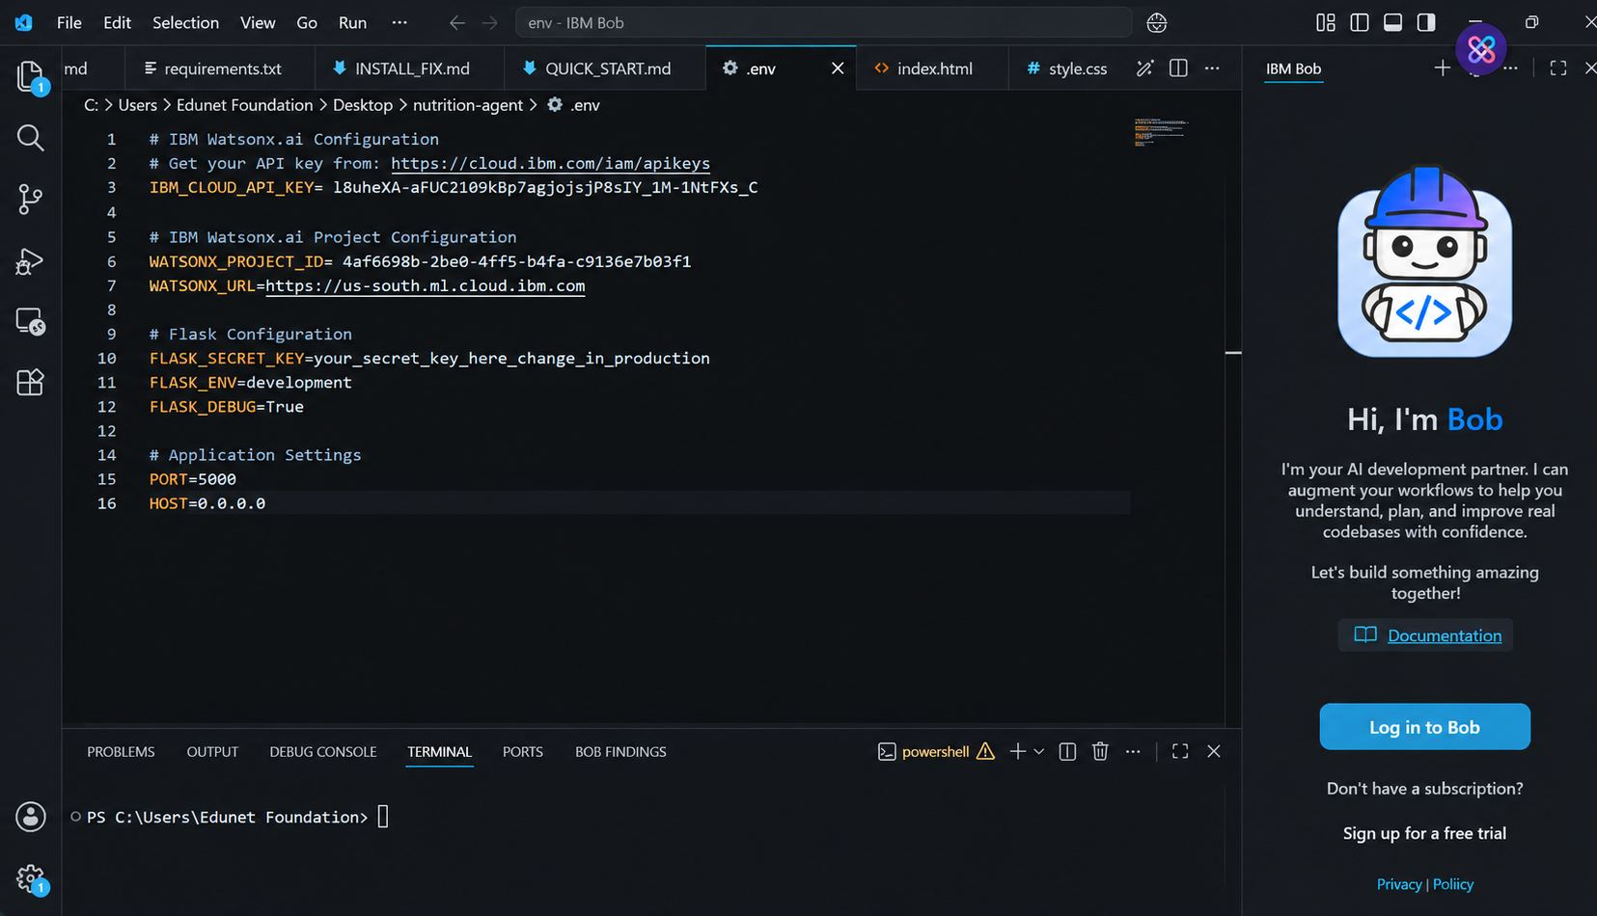
Required Files created using IBM bob -
App.py
Requirements.txt
Style.css
Index.html

Slide 7
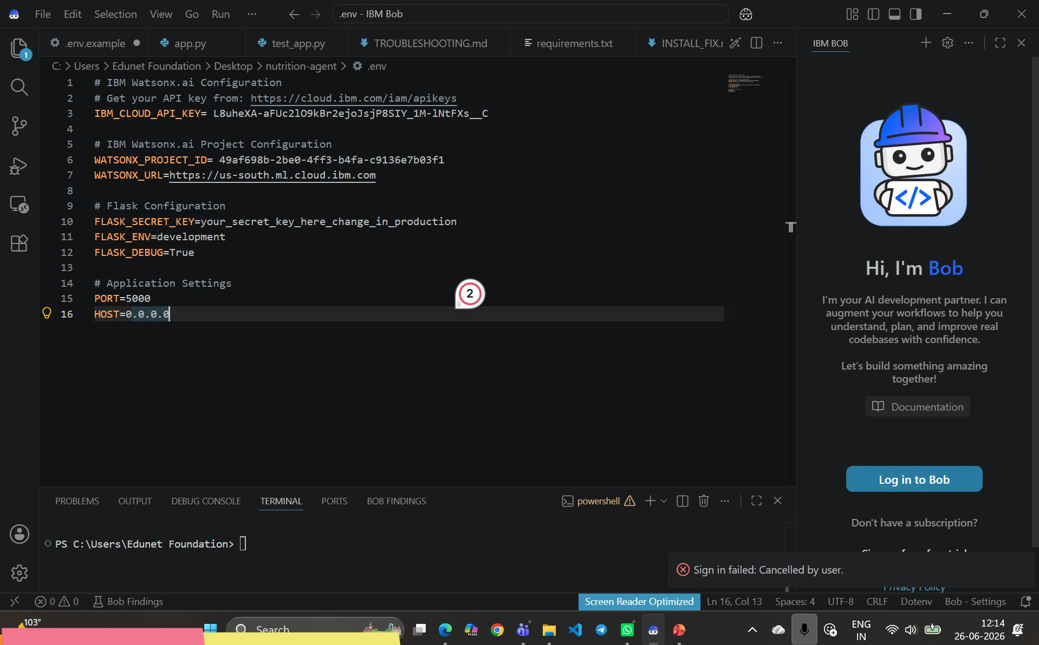
IBM Bob Screenshots:

Slide 8
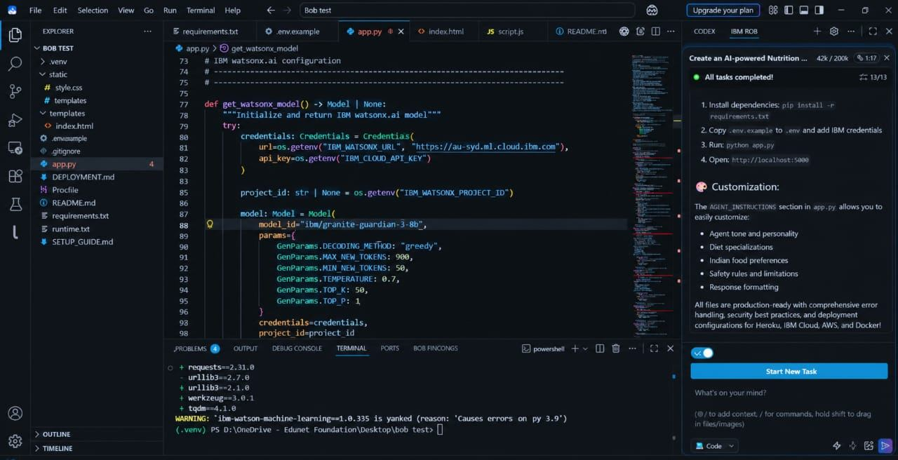

Slide 9
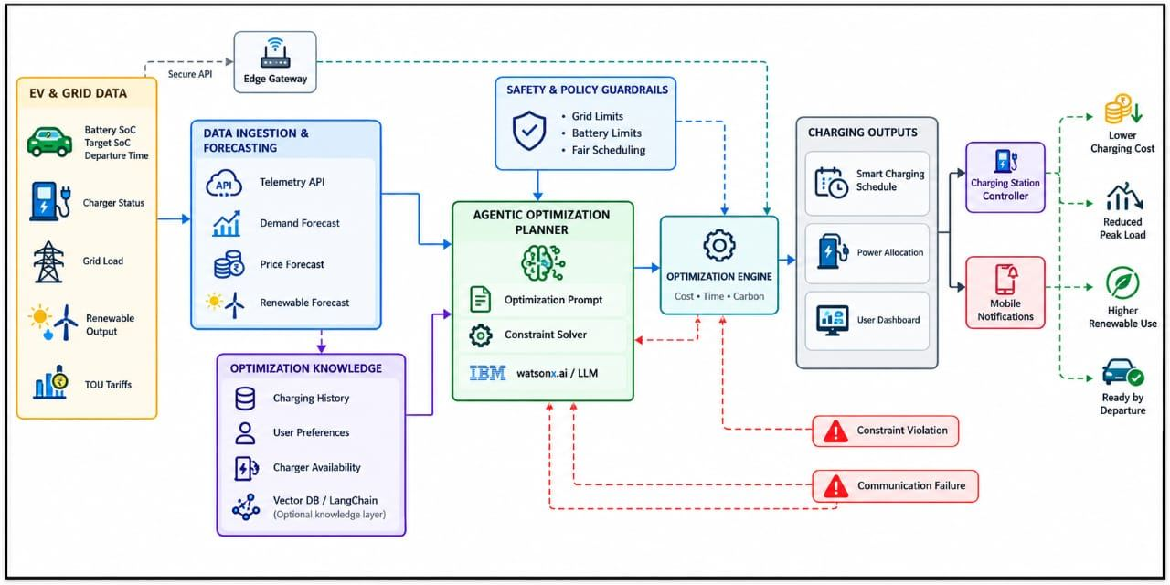
Architecture blueprint for IBM bob:

Slide 10

Role of Agentic AI in the solution
Role of Agentic AI in the Solution:
Agentic AI plays a key role in the Electric Vehicle Charging Optimization Agent by autonomously analyzing charging requirements, making intelligent decisions, and recommending optimal charging solutions.
1. Intelligent Decision-Making: Analyzes battery levels, user preferences, electricity prices, and charging requirements to select the most suitable charging option.
2. Real-Time Data Analysis: Retrieves charging station availability, charging rates, and electricity prices to provide updated recommendations.
3. Charging Schedule Optimization: Automatically identifies the best charging time based on electricity costs, energy demand, and user requirements.
4. Smart Route and Station Selection: Recommends suitable charging stations along the user's route to reduce unnecessary travel and waiting time.
5. Continuous Monitoring and Adaptation: Monitors changes in station availability and electricity prices and adjusts recommendations accordingly.
6. Energy Efficiency and Cost Reduction: Helps reduce charging expenses, balance electricity demand, improve charging station utilization, and support sustainable transportation.

Slide 11
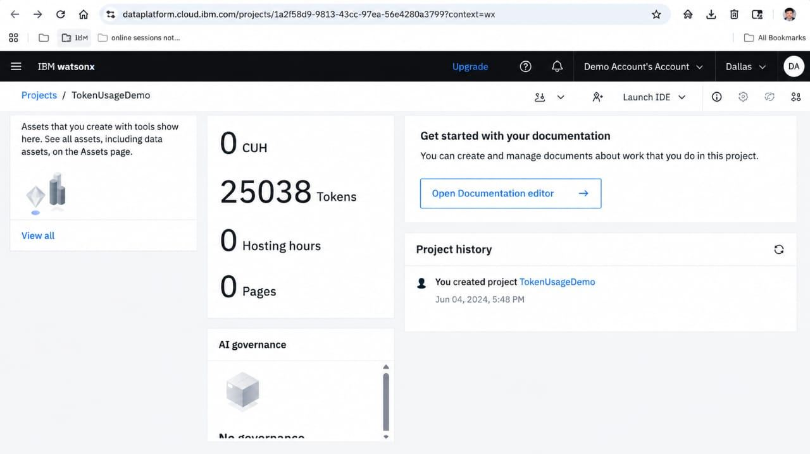
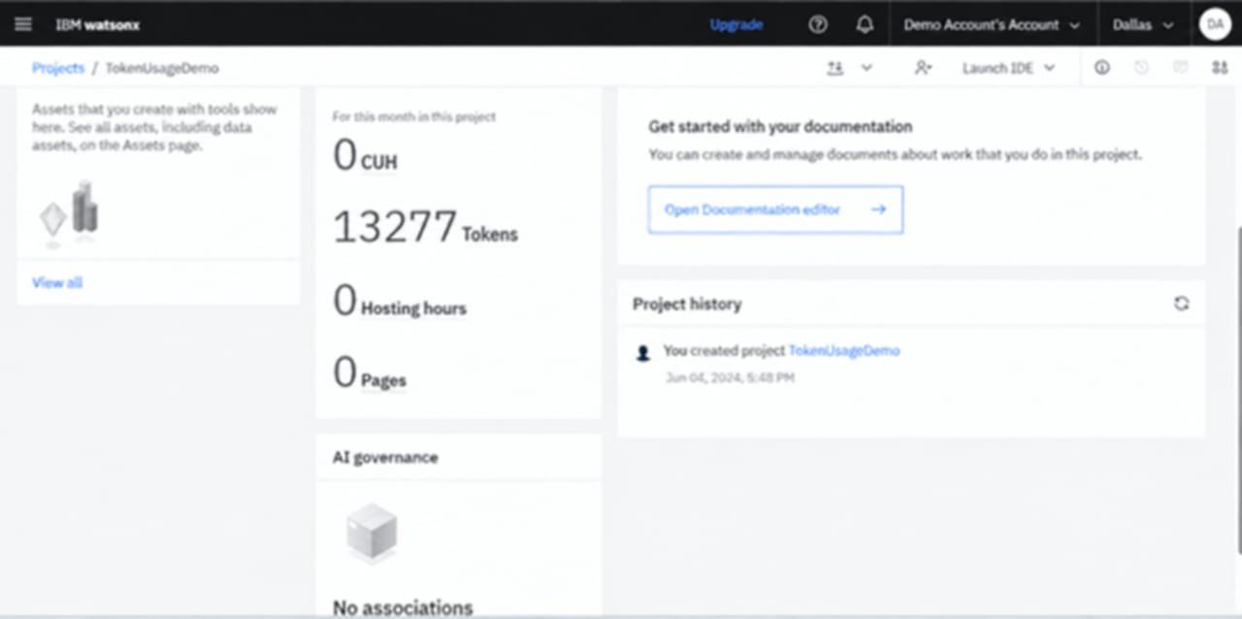
Token Usage
11,761 token are used
Before Prompt
After the Prompt
·
·
·

Slide 12
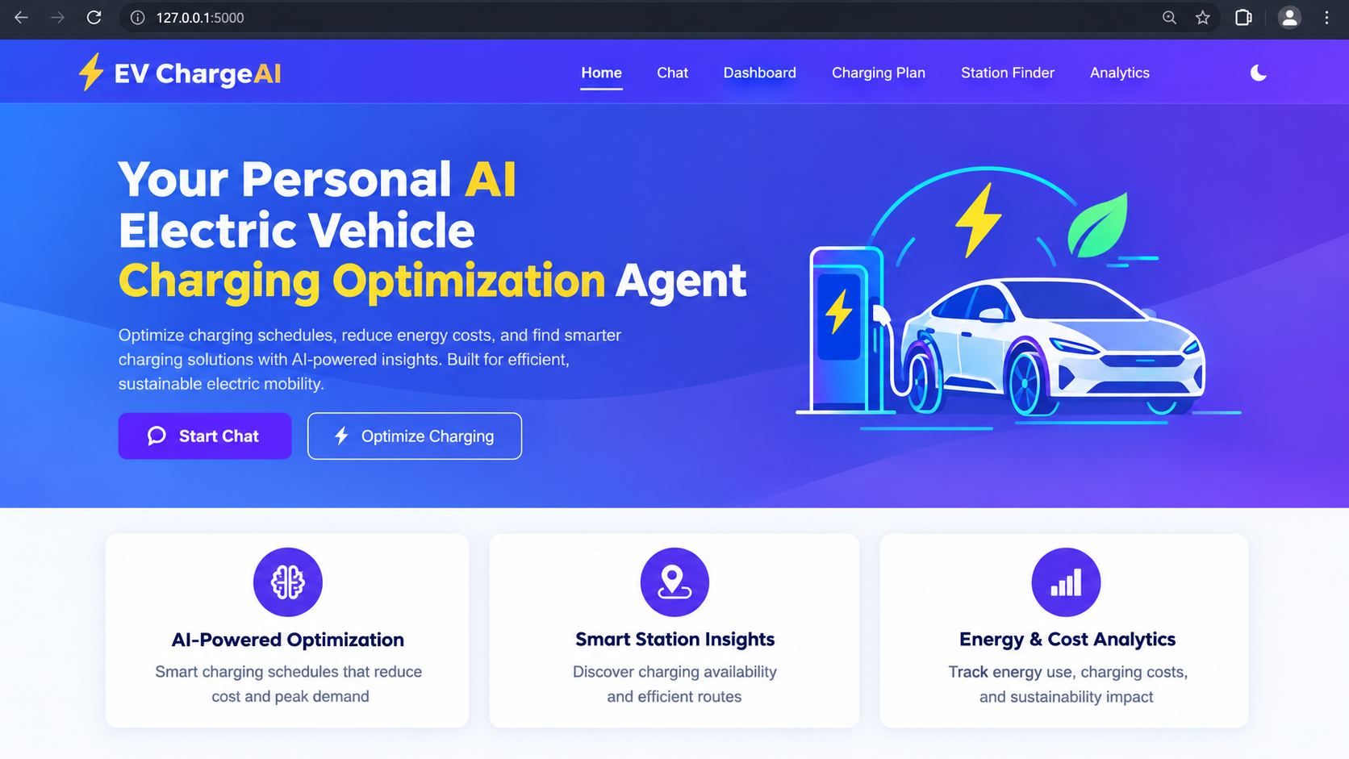
Project Output Screenshot
Please put IBM Bob output screenshots with 2-3 prompts.
You can take 2-3 more slides for each screenshot
·
·
·

Slide 13
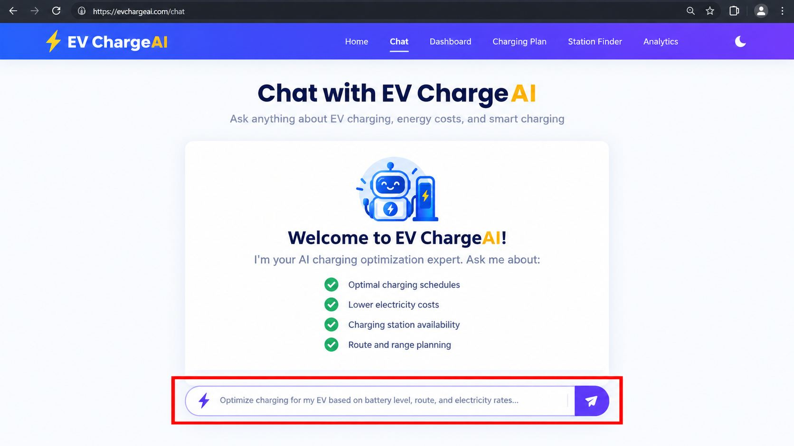
Project Output Screenshot
Please put IBM Bob output screenshots with 2-3 prompts.
You can take 2-3 more slides for each screenshot
·
·
·

Slide 14
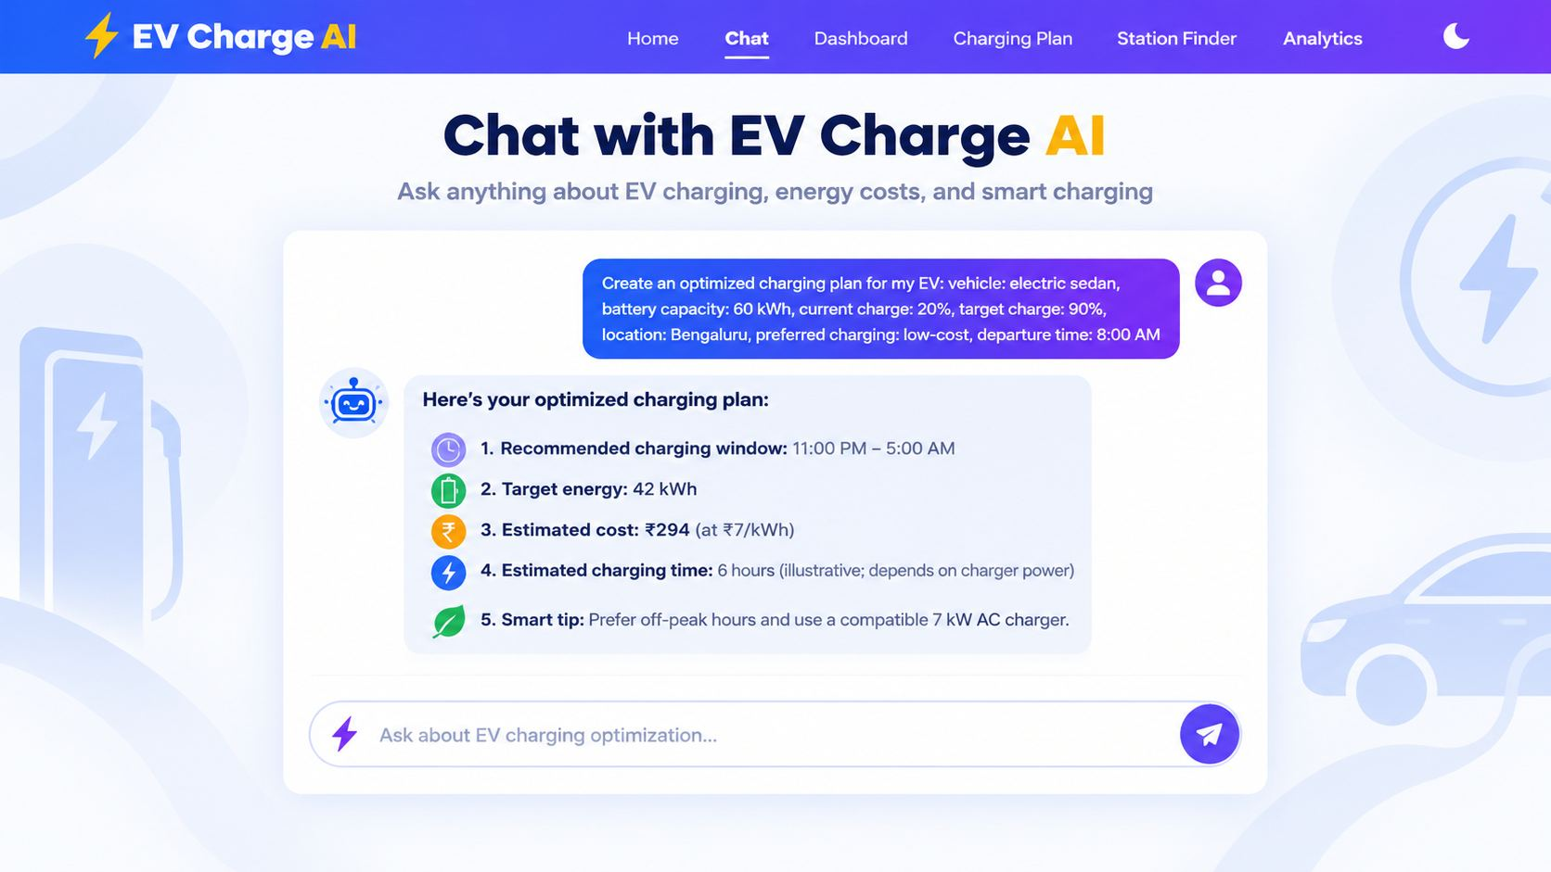
Project Output Screenshot
Please put IBM Bob output screenshots with 2-3 prompts.
You can take 2-3 more slides for each screenshot
·
·
·

Slide 15
Novelty and Uniqueness
The proposed Electric Vehicle Charging Optimization Agent stands out by combining Agentic AI, RAG, and intelligent optimization into a single smart charging system.
Multi-Agent Intelligence – Multiple specialized agents collaborate to analyze battery levels, charging station availability, electricity prices, and user requirements to recommend optimal charging solutions.
RAG-Based Accuracy – Retrieves relevant and updated information about charging stations, charging rates, and energy-management guidelines before generating recommendations, improving their reliability.
Intelligent Charging Optimization – Optimizes charging schedules based on electricity prices, battery requirements, energy demand, and user preferences to reduce charging costs.
Real-Time Feedback Loop – Continuously adapts recommendations when station availability, electricity prices, traffic conditions, or charging requirements change.
Smart Route and Station Selection – Suggests suitable charging stations along the user's route to reduce unnecessary travel, waiting time, and range anxiety.
Sustainable Energy Management – Encourages off-peak charging and the use of renewable energy when available, helping reduce electricity demand during peak periods and supporting sustainable transportation.
Scalable and Intelligent Architecture – Can use an agent orchestration platform, a RAG pipeline, and a vector database such as FAISS or Chroma to coordinate specialized agents and retrieve relevant charging information efficiently.
This makes the solution a smart, adaptive, and proactive EV charging assistant rather than a simple charging station locator.

Slide 16
Git Hub Link
GitHub Repository Name: EV-Charging-Optimization-Agent
Repository Type: Public
GitHub Repository URL:
https://github.com/peddadevarajaveed-786/EV-Charging-Optimization-Agent-/upload/main
Files Uploaded:
IBM Cloud Agent Relevant Files
problemstatement.pdf
projectpresentation.pptx
README.md and other related project files
·
·
·

Slide 17
Future Scope
1. Integration with Smart Charging Stations and IoT Devices – The system can be integrated with smart EV charging stations and Internet of Things (IoT) devices to collect real-time data such as battery level, charging speed, station availability, and electricity consumption. This enables the Electric Vehicle Charging Optimization Agent to recommend suitable charging stations, optimize charging schedules, and improve energy efficiency based on current conditions.
2. AI-Powered Voice Assistant and Multilingual Support – Enhancing the system with a voice-enabled assistant and multilingual support will improve accessibility and user convenience. EV owners can interact with the agent in their preferred language to find nearby charging stations, check charging costs, receive route-based charging recommendations, and get updates about station availability. This makes the solution more user-friendly and accessible to a wider range of electric vehicle users.
·
·
·

Slide 18

Certificates Earned:

Slide 19

Certificates Earned:​

Slide 20


